Slide 1


Privacy & Review
SE3331-1 (2023 Fall)
IPADS, Shanghai Jiao Tong University
https://www.sjtu.edu.cn

Slide 2
Process of fixing a bug/vulnerability
1 发现
2 汇报
Based on a real case (Credit: Fan Yang)
  CVE-2020-10757
  Linux commit 5c7fb56e5e3f
Phase-1: finding a bug
  Survey whether the bug has been found
  Simply the process of re-producing bug
  Evaluate the seriousness, if belongs to security, offer an exploit
  Provide a patch if you have one.
3 处理
4 公开
TCB: Yourself

Slide 3
Fix the Bug
1 发现
2 汇报
3 处理
4 公开
Phase-2: Report
  Not security bug：kernel mailing list, bugzilla
  Security bug：security@kernel.org
  Require a CVE id (Common Vulnerability and Exposures List)
    Not public yet
    CVE status is RESERVED
public
Non-public
TCB: Mailing list + Yourself

Slide 4
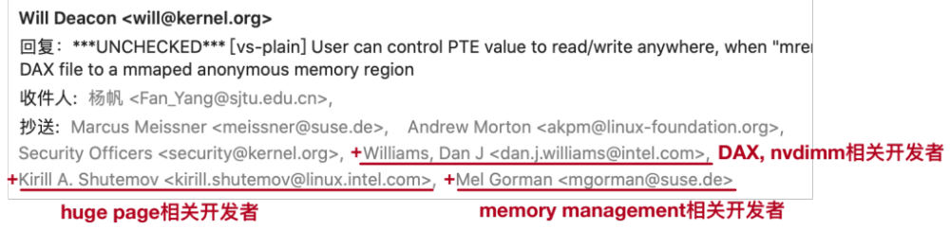
Fix the Bug
1 发现
2 汇报
3 处理
4 公开
Phase-3: handle the bug
  Related developers and maintainers join the discussion
TCB: Related developers + Mailing list + Yourself

Slide 5
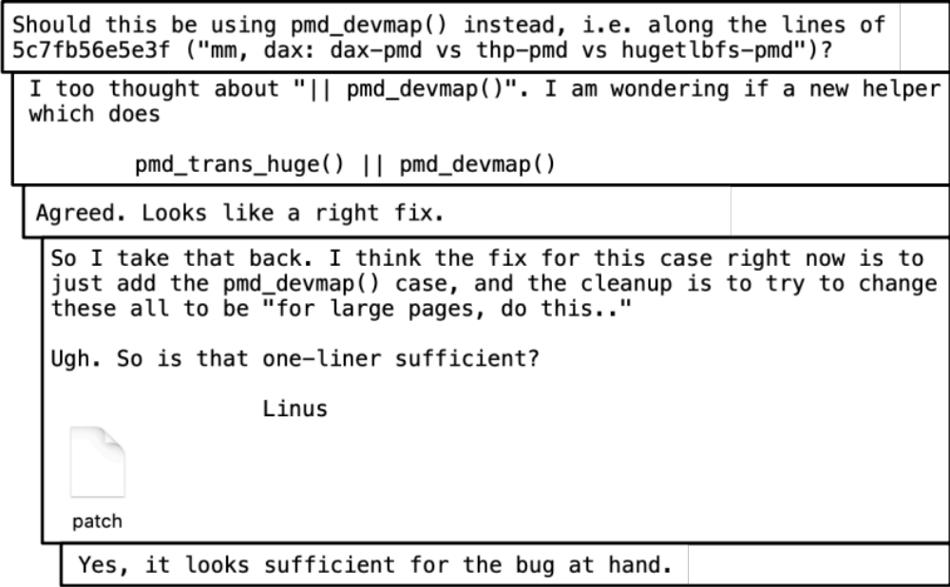
Fix the Bug
1 发现
2 汇报
3 处理
4 公开
Phase-3: handle the bug
  Patch proposing and discussion

Slide 6
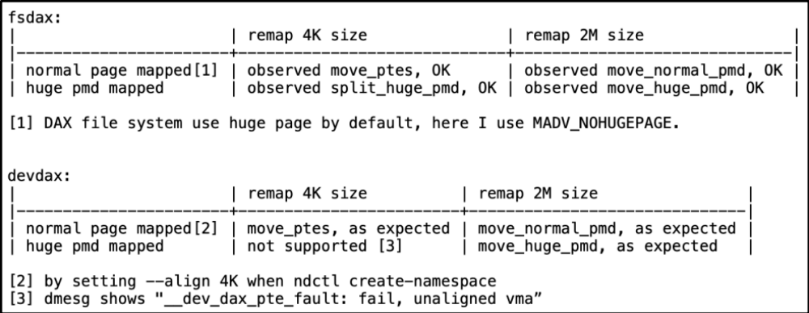
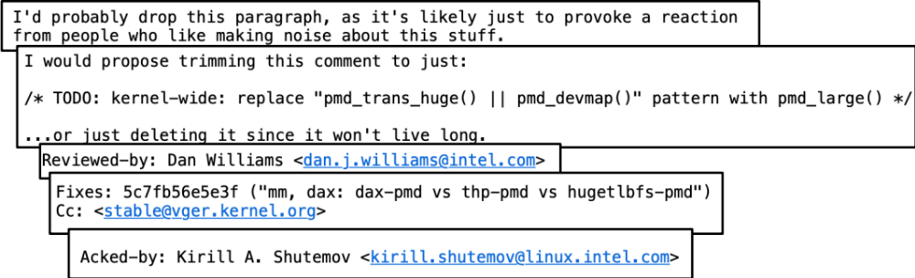
Fix the Bug
1 发现
2 汇报
3 处理
4 公开
Phase-3: handle the bug
  Test and patch review

Slide 7
Fix the Bug
1 发现
2 汇报
3 处理
4 公开
Phase-3.5：Embargo Period （可选）
  discuss with maintainers of distributions, prepare to fix
  Why not just fix it?
    Submit a patch in public mailing list means public
    Prevent distributions not fix the bugs in time
  Decide whether embargo period is needed: evaluate
3.5 Embargo

Slide 8

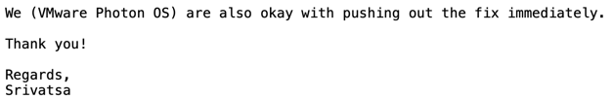
Fix the Bug
1 发现
2 汇报
3 处理
4 公开
Phase-3.5：Embargo Period
  You can negociate Embargo Period
3.5 Embargo
TCB: Distributions + Related developers + Mailing list + Yourself

Slide 9

Fix the Bug
1 发现
2 汇报
3 处理
4 公开
3.5 Embargo
Phase-4: Public
  Merge to mainstream
  Backport to related stable versions
  Publish to public mailing list, security group
    E.g., oss-security@lists.openwall.com
  Update CVE status to public
TCB: All!

Slide 10
Privacy

Slide 11
Data Privacy
Data can be used everywhere
  Risk management
  Medicine
  Recommended system
  …
Data can be stolen easily
  Everyone who uses your data can steal it

Slide 12
Data Privacy
What’s the target of data privacy system?
  Allow data to be used, and protect it from being stolen
Today's contents
  Basic data privacy method
    ZKP, OT, HE, sMPC, TEE, DP
  Systems which try to enforce data privacy

Slide 13
Common Attacks
An adversary may learn about data:
From ciphertext (ciphertext representation-based attack, e.g., order of values)
From prior knowledge of data distribution (frequency-count attack)
From knowledge of frequency of queries (workload-skew attack)
From the size of the output to a query (output-size attack)
From the access pattern used by the mechanism in answering a query (access-pattern attack)
From knowledge of queries that have executed (search-pattern attack)
Mix with adversarial background knowledge
Data Privacy compromised!!

Slide 14
OT
Oblivious Transfer

Slide 15


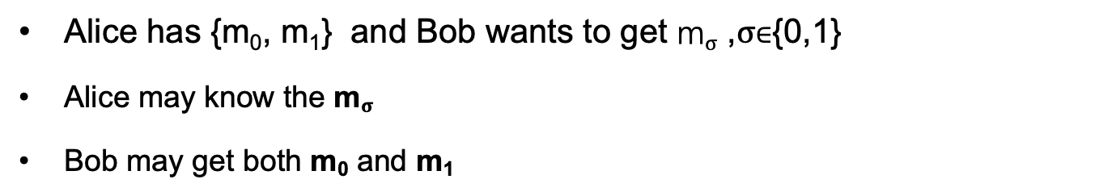
Problem
I have {m₀, m₁}
I want to get m$σ$
Alice
Bob
Alice has {m₀, m₁} and Bob wants to get m$σ$ ,$σ$∈{0,1}
Alice may know the m$σ$
Bob may get both m₀ and m₁

Slide 16
Oblivious Transfer (OT)
Introduced by Michael O. Rabin, 1981
Scenario: message transfer
  A sender has a message list {m₀, m₁, … , m_{n}}
  A receiver wants to get k target messages from sender
Properties: oblivious and secure
  Oblivious: sender cannot know which messages are received
  Secure: receiver can only get the target messages

Slide 17
1-out-of-2 OT (one solution)
Scenario: RSA encryption
{m₀, m₁}
m$σ$ = ?
Alice
Bob
Generate 2 key pairs {K0_{pub}, K0_{prv}}, {K1_{pub}, K1_{prv}}
K0_{pub}, K1_{pub}
Generate a random number r
c ← Enc(Kσ_{pub}, r)
c
k₀ ← Dec(K0_{prv}, c)
k₁ ← Dec(K1_{prv}, c)
e₀ ← k₀ ⊕ m₀
e₁ ← k₁ ⊕ m₁
e₀, e₁
m_{σ} ← e_{σ} ⊕ r

Slide 18
1-out-of-2 OT (Solution-2)
m$σ$ = ?
{m₀, m₁}
Alice
Bob
Generate ${(K}_{pub}, K_{prv})$
Select random numbers $r_{0},$ $r_{1}$
$$K_{pub}, r_{0},r_{1}$$
Genearte a key $k$
$V=Enc\left(K_{pub}, k\right)⊕r_{σ}, σ∈\{0,1\}$
$$V$$
$k_{0}=Dec\left(K_{prv},V⨁{ r}_{0}\right)$
$k_{1}=Dec\left(K_{prv},V⨁{ r}_{1}\right)$
$C_{0}=Enc\left(k_{o}, { m}_{0}\right)$
$C_{1}=Enc\left(k_{1}, { m}_{1}\right)$
$$C_{o},C_{1}$$
$m_{σ} =Dec\left(k, C_{σ}\right)$
Notes:
Alice分别用两个解密结果加密她的两份消息，将加密结果送给Bob （Ci=E(ki, mi) i=0,1）
Bob用k解密两份密文，得到需要的秘密 s

Slide 19
More OT Protocols
Different numbers of selected messages
  1-out-of-2 OT
  1-out-of-n OT
  k-out-of-n OT
Implementation method
  Non-adaptive OT
  Adaptive OT
  Publicly Verifiable OT
  …

Slide 20
DP
Differential privacy

Slide 21


Problem
Name | Salary
Alice | 100
Bob | 80
Brown | 200
Tom | 120
SUM(Salary)
500
Alice can perform queries on Bob’s database, but cannot access a single database entry

Slide 22
Problem
Name | Salary
Alice | 100
Bob | 80
Brown | 200
Tom | 120
SUM(Salary) where Name == “Tom”
Reject
Alice can perform queries on Bob’s database, but cannot access a single database entry
  Naïve method: reject Alice to access single entry

Slide 23
Problem
Tom has 120
Name | Salary
Alice | 100
Bob | 80
Brown | 200
Tom | 120
SUM(Salary)
500
SUM(Salary) where Name != “Tom”
380
Alice can perform queries on Bob’s database, but cannot access a single database entry
  Naïve method: reject Alice to access single entry

Slide 24
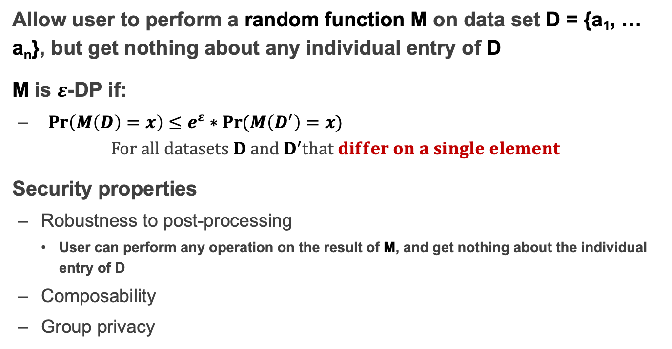
Differential privacy
Allow user to perform a random function M on data set D = {a₁, … a_{n}}, but get nothing about any individual entry of D
M is $ε$-DP if:
  ${Pr\left(M\left(D\right)=x\right)}≤e^{ε}∗Pr⁡(M\left(D^{′}\right)=x)$
  $For all datasets D and D^{′}that differ on a single element$
Security properties
  Robustness to post-processing
    User can perform any operation on the result of M, and get nothing about the individual entry of D
  Composability
  Group privacy

Slide 25
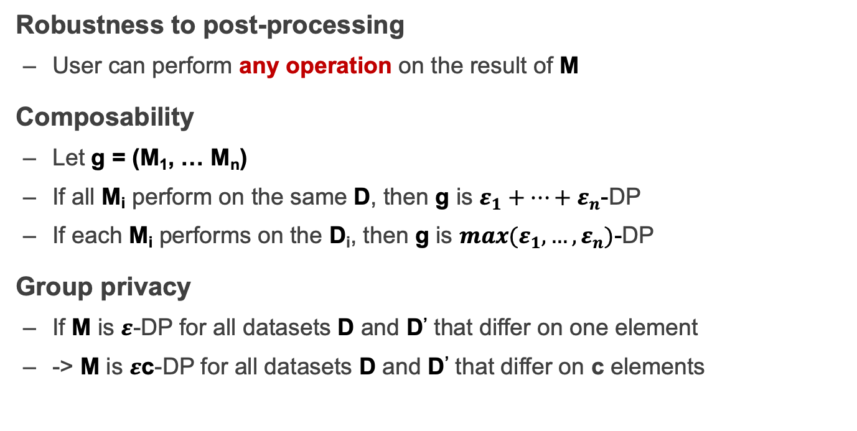
Properties of Differential privacy
Robustness to post-processing
  User can perform any operation on the result of M
Composability
  Let g = (M₁, … M_{n})
  If all M_{i} perform on the same D, then g is $ε_{1}+…+ε_{n}$-DP
  If each M_{i} performs on the D_{i}, then g is ${max(ε}_{1},…,ε_{n})$-DP
Group privacy
  If M is $ε$-DP for all datasets D and D’ that differ on one element
  -> M is $ε$c-DP for all datasets D and D’ that differ on c elements

Slide 26
How to Implement a DP Algorithm
Adding noisy to the function that we want to compute
  Translate the function f to a random algorithm M
Existing Mechanism
  Laplace mechanism
  Gaussian mechanism
  …

Slide 27
When DP is Enabled
…
Name | Salary
Alice | 100
Bob | 80
Brown | 200
Tom | 120
SUM(Salary)
~480
SUM(Salary) where Name != “Tom”
~480

Slide 28
Secret Sharing

Slide 29
Secret Sharing
Introduced by Adi Shamir, 1979
Key Insight: One point constructs infinite number of lines, two points construct only one line
Key Idea: Split a secret data into n shares, at least k shares can reconstruct the secret ((k,n)-SS)

Slide 30

Secret Sharing
Each part cannot learn the secret S
Secret-Share Creation:
(under the assumption that no part will collude)
share 1
part 1
share 2
secret data S
part 2
share 3
secret owner
share n
part 3
Mathematical operations
f(x) = S + a₁x + a₂x + ... + a_{k-1}x^{k-1}
…
part n

Slide 31
Secret Sharing
Each part cannot learn the secret S
Secret Reconstruction:
(under the assumption that no part will collude)
share 1
part 1
share 2
secret data S
part 2
share k
secret owner
part 3
Lagrange Interpolation
…
part n

Slide 32
Secret Sharing
Each part cannot learn the secret S
Secret Reconstruction:
(under the assumption that no part will collude)
share 1
part 1
secret data S
part 2
share 3
share k
secret owner
part 3
Lagrange Interpolation
…
part n

Slide 33
Pros and Cons
An information-theoretically secure protocol (unconditionally secure, independent of adversary's computational capabilities → quantum-safe)
Ideal assumption (At least k parts never collude)
Communication overhead

Slide 34
Secure MPC
Multi-Party Computing

Slide 35
secure Multi-Party Computation (sMPC)
We want to calculate
f(data₁, data₂)
I have data₁
I have data₂
Alice
Bob
Multiple parties (at least 2) work together to calculate a function
  Enforce the data privacy for each party

Slide 36
Millionaire Problem
Money: Bob has i, Alice has j, i and j are between 1 to 10
Alice
Bob
  Chose a random big integer x
  K = enc{Key_{pub} of Bob, x}
  Decrypt with Key_{prv} of Bob ten number: c+1, c+2...c+10, get y1, y2... y10
  Chose a prime number p
  Calculate d1 = y1 mod p,
  d2 = y2 mod p, ...
  For n=i to 10, d_{n}++, other no change
c=K-j
d₁ to d₁₀
  Check dj, if dj == x mod p, then i > j; else i <= j

Slide 37
secure Multi-Party Computation (sMPC)
Semi-honest adversary
  Each party must follow the protocol
Generic protocol
  Can securely compute any functionality
Multi-party computation
  Secret sharing
2-party computation
  GC(Garbled Circuits) + OT(Oblivious Transfer)

Slide 38
HE
Homomorphic Encryption

Slide 39

Problem
I have Data!
I have computing resource!
Data
Alice
Bob (cloud)
Alice wants to ask Bob (e.g., a cloud) to perform calculation on her data
Naïve method: Sending Data to Bob
  Bob will get the data

Slide 40
Homomorphic Encryption (HE)
I have Data!
I have computing resource!
Alice
Bob (cloud)
CT=encrypt(Key, Data)
Function f()
CT'= Evaluate(f, CT) = Encrypt(Key, f(Data))
Get f(Data) = Decrypt(Key, CT')

Slide 41
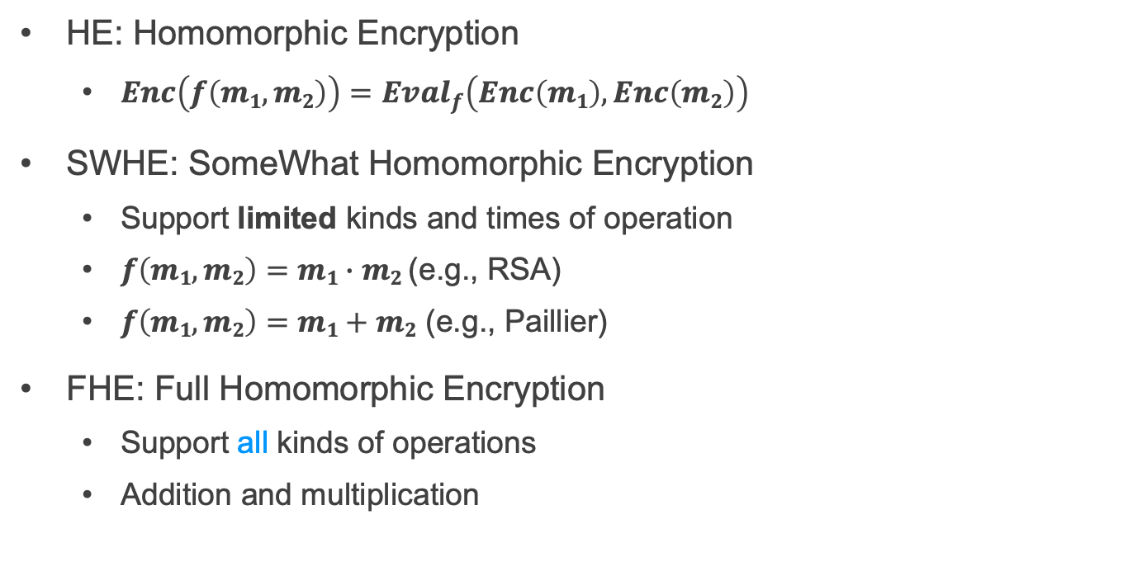
SWHE and FHE
HE: Homomorphic Encryption
  $Enc\left(f\left(m1,m2\right)\right)={Eval}_{f}\left(Enc\left(m1\right), Enc\left(m2\right)\right)$
SWHE: SomeWhat Homomorphic Encryption
  Support limited kinds and times of operation
  $f\left(m1,m2\right)=m1∙m2$ (e.g., RSA)
  $f\left(m1,m2\right)=m1+m2$ (e.g., Paillier)
FHE: Full Homomorphic Encryption
  Support all kinds of operations
  Addition and multiplication

Slide 42
TEE
Trusted Execution Environment

Slide 43
Problem
I have Data!
I have computing resource!
Data
Alice
Bob (cloud)
Alice wants to ask Bob (e.g., a cloud) to perform calculation on her data
Naïve method: Sending Data to Bob

Slide 44
Trusted Execution Environment (TEE)
I have Data!
I have computing resource and enclave!
Data
Alice
Bob (cloud)
Alice wants to ask Bob (e.g., a cloud) to perform calculation on her data
Naïve method: Sending Data to Bob
Bob cloud construct an enclave

Slide 45
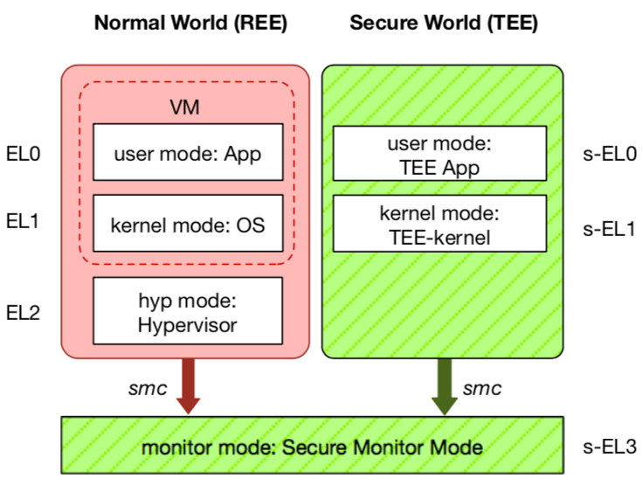
TEE: Trusted Execution Environment
Widely deployed on mobile devices
  Every Android device must deploy TEE
  Mostly based on ARM TrustZone
An isolated & privileged environment
  TEE can access all DRAM & peripherals
  REE cannot access TEE's resources
Designed to be secured and small
  For security-critical tasks (e.g., fingerprint
  checker, mobile payment, etc.)
Notes:
Before presenting virtualization of TEE, let me introduce TEE a little bit.
TEE is short for xxx. It has been widely deployed on mobile devices. Thanks to Google, now every Android phone needs to have TEE to pass Google's test.
On mobile phone, most TEE are based on ARM TrustZone.
TrustZone divides one system to two worlds: xxx and xxx.
The normal world, aka REE, runs rich OS like Android or iOS. It has three layers: one for hypervisor, one for kernel and one for application.
The secure world, aka TEE, has three layers: one for TEE OS and one for TEE applications.
There is a special layer, called monitor mode or s-EL3, is used for switching between the two worlds. It is also part of the secure world but share the same privilege with s-EL1.
The switching is done through smc instruction.
The green part is TEE, which is an isolated environment with higher privileged than the REE.
It means that xxx
The TEE is designed to xxx, its typical usage is xxx.

Slide 46
Two Features of TEE
1. Isolated execution
Minimal TCB: system software is not trusted
  E.g., OS and hypervisor
Some can prevent physical attacks
  With memory encryption
2. Remote attestation
Prove itself to the end users
Usually use SSL to establish a secure channel over network

Slide 47
Different TEEs
Software TEE
  VM-based TEE
  Same privilege protection
ARM TrustZone
Intel SGX
AMD SME/SEV
SANCTUM
Notes:
However, the openness also leads to fragmentation.
Nowadays, there are many different kinds of TEE OS, from different venders.
Also, many other implementations based on OP-TEE.
This is not a good news for trusted app developers, since they need to port and trust.

Slide 48
Review: Security

Slide 49
2 Steps towards Building a More Secure System
How to make progress in building a secure system?
  Be clear about goals: "policy"
  Be clear about assumptions: "threat model"

Slide 50
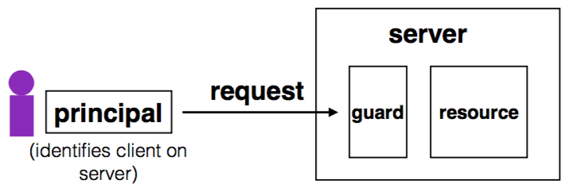
Complete Mediation
Guard typically provides:
  Authentication: is the principal who they claim to be?
  Authorization: does principal have access to perform request on resource?

Slide 51
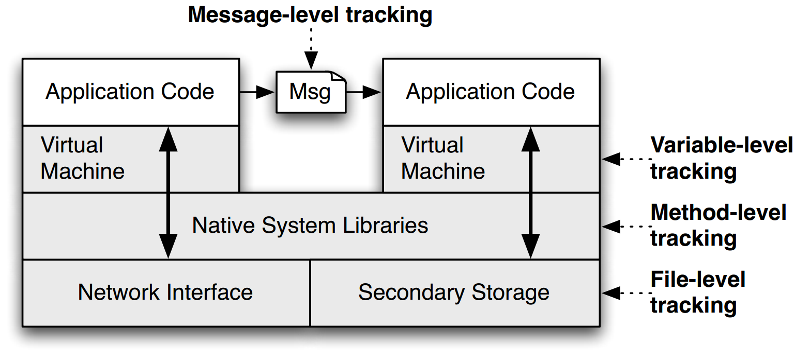
TaintDroid
Notes:
This is a figure from the conference paper describing TaintDroid. It shows where, at a high level, the various kinds of taint analysis are done. There are 4 "granularities" of taint analysis used in TaintDroid, including message-level, variable-level, method-level, and file-level.

Slide 52
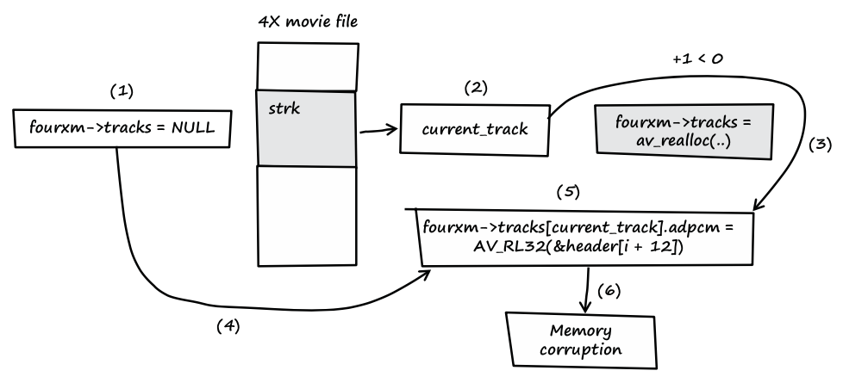
Trace the Input Data
Notes:
fourxm->tracks is initialized with NULL (see line 107).
If the processed media file contains a strk chunk, the value of current_track is extracted from the user-controlled data of the chunk (see line 166).
If the value of current_track + 1 is less than zero, the heap buffer isn't allocated.
fourxm->tracks still points to memory address NULL.
The resulting NULL pointer is then dereferenced by the user- controlled value of current_track, and four 32-bit values of user- controlled data are assigned to the dereferenced locations (see lines 178–181).
Four user-controlled memory locations can be overwritten with four user-controlled data bytes each.

Slide 53
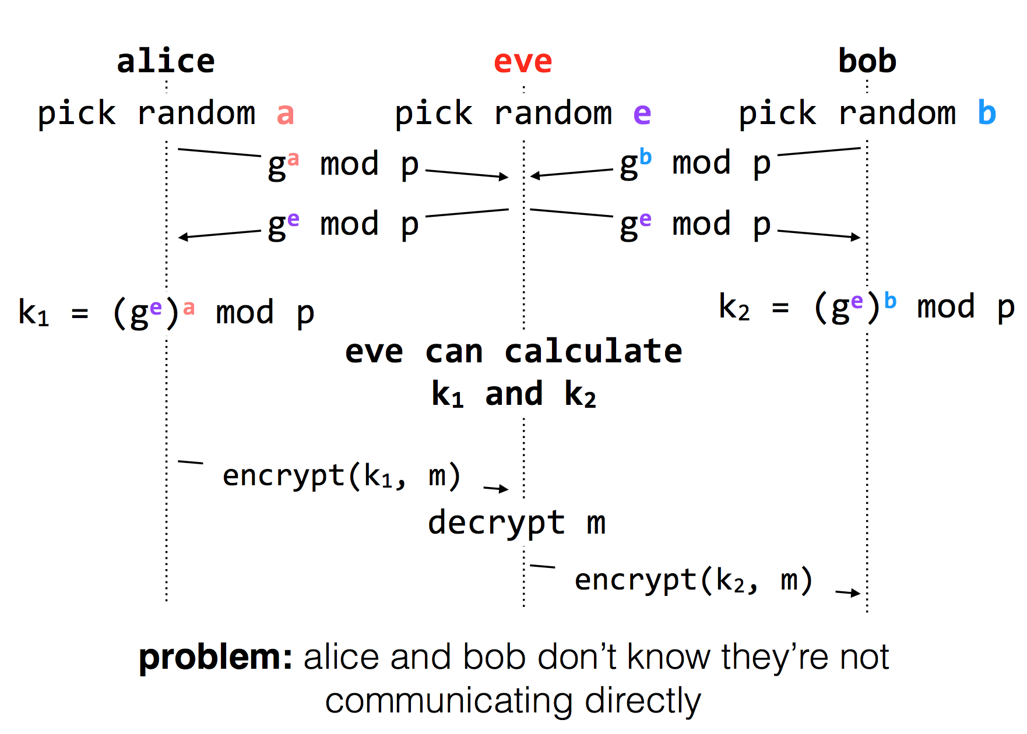
Diffie-Hellman Key Exchange & Man-in-the-Middle

Slide 54
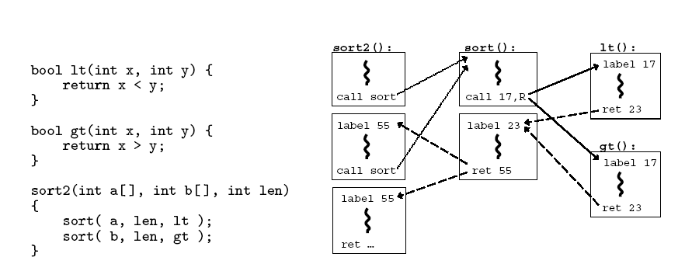
CFI: Control Flow Integrity

Slide 55
Review: Network

Slide 56
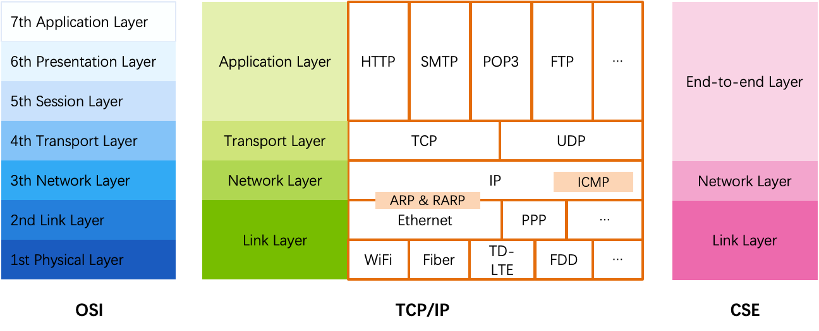
OSI, TCP/IP & Protocol Stack
OSI
  The open systems interconnection (OSI) model
  7-layer architecture

Slide 57
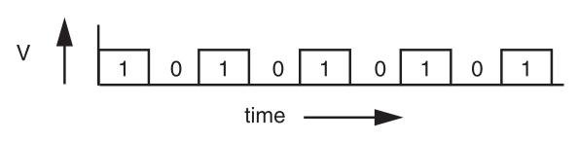
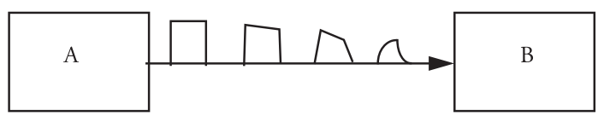
Signal Transmission on Analog Line
It is hard for B to understand the signal
  B doesn't have a copy of A's clock, so when to sample the signal?

Slide 58
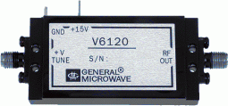
VCO: Voltage Controlled Oscillator
How to make two ends agree on the data rate without clock line?
The receiver run a VCO at about the same data rate
  VCO's output is multiplied by the voltage of incoming signal
  The product is suitably filtered and sent back to adjust the VCO
  VCO will finally be locked to both the frequency and phase of the arriving signal: phase-locked loop
  Then the VCO becomes a clock source for the receiver
Problem: if no transition in the stream (e.g., a lot of zero), the phase-locked loop cannot synchronize

Slide 59
Manchester Code
Solution: sender encodes the data to ensure transitions
Phase encoding: at least 1 level transition for a bit
  Manchester code: 0 -> 01, 1 -> 10
  Max data rate is only half, but simple enough
1
0
1
0
1
1
1
0
0
Polar NRZ
Manchester
Encoding

Slide 60
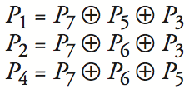
Example-2: 4-bit -> 7-bit
4 bits -> 7 bits (56 using only extra 7)
  3 extra bits to distinguish 8 cases
  e.g. 1101 -> 1010101
Correct 1-bit errors
  1010101 -> 1010001 : P1 & P4 not match
  1010101 -> 1110101 : P2 not match
Not Match | Error
None | None
P1 | P1
P2 | P2
P4 | P4
P1 & P2 | P3
P1 & P4 | P5
P2 & P4 | P6
P1 & P2 & P4 | P7
1 2 3 4 5 6 7
1
0
1
0
1
0
1
1
0
1
0
1
0
1
1
0
1
0
1
0
1

Slide 61
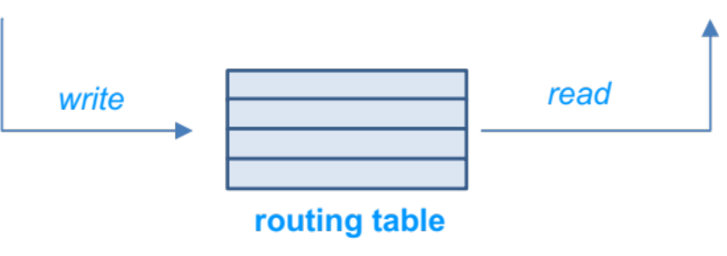
Control-plane VS. Data-plane
Control-plane
  Control the data flow by defining rules
  E.g., the routing algorithm
Data-plane
  Copies data according to the rules
  Performance critical
  E.g., the IP forwarding process

Slide 62
Assurance of End-to-end Protocol
Assurance of at-least-once delivery
Assurance of at-most-once delivery
Assurance of data integrity
Assurance of stream order & closing of connections
Assurance of jitter control
Assurance of authenticity and privacy
Assurance of end-to-end performance

Slide 63
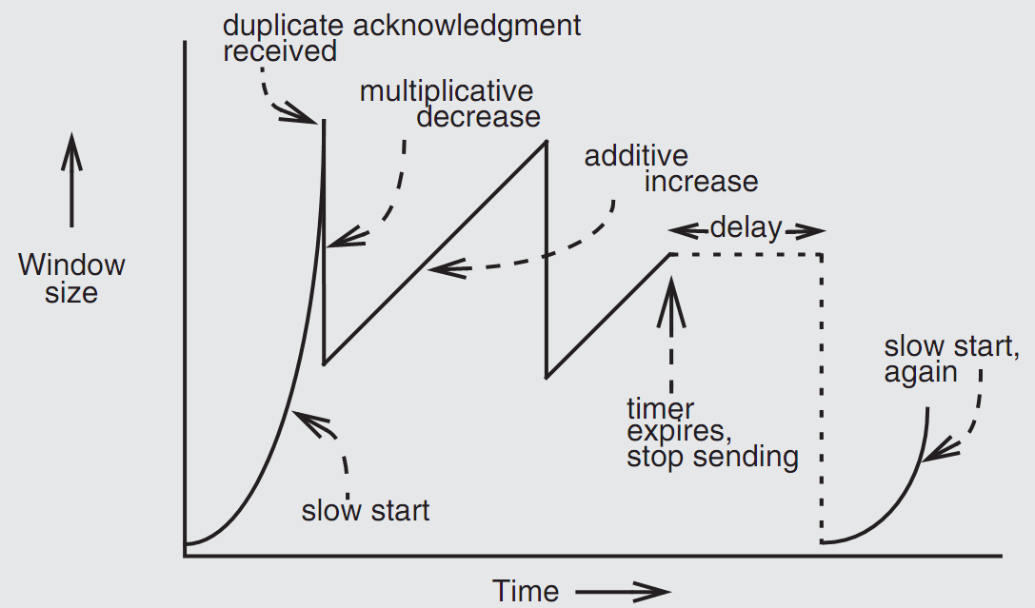
Retrofitting TCP

Slide 64
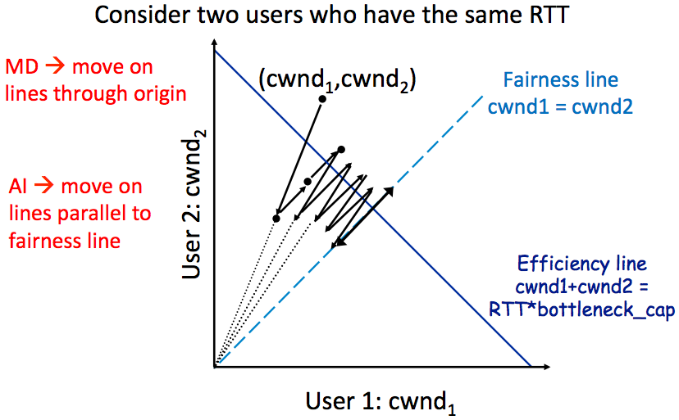
AIMD Leads to Efficiency and Fairness

Slide 65
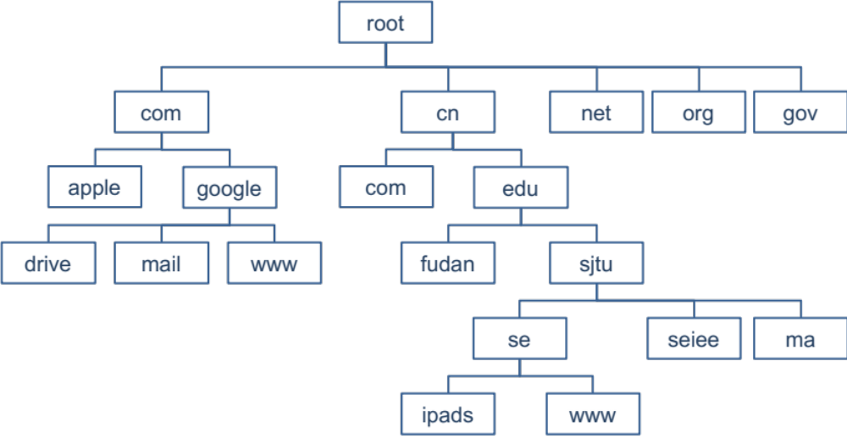
DNS Hierarchy (a partial view)

Slide 66
DNS Request Process
a.root.net
a.root.net
names.edu
names.edu
NS: for edu
ns.iss.edu
ns.iss.edu
NS: for
Scholarly.edu
ginger.
Scholar.edu
ginger.
Scholar.edu
ginger.
Scholar.edu
AP: for
ginger.Scholar.edu
Name client
Name client
Non-Recursion
Recursion

Slide 67
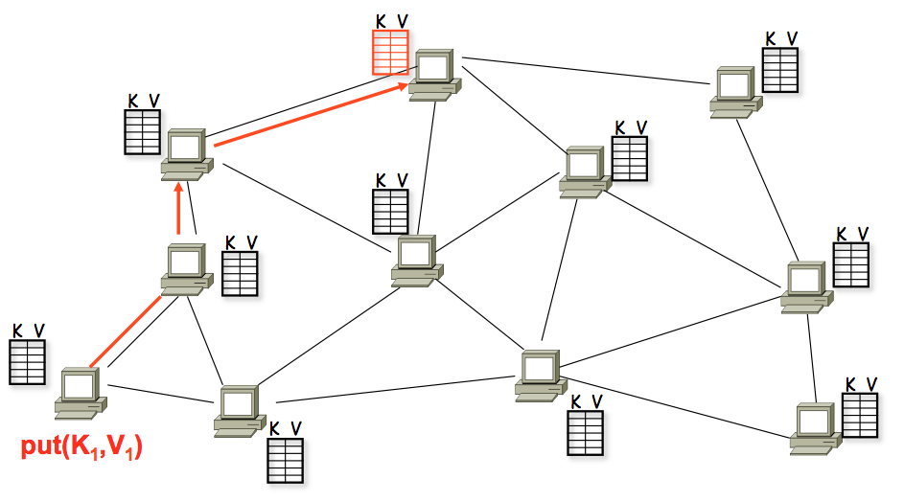
A DHT in Operation: put()

Slide 68
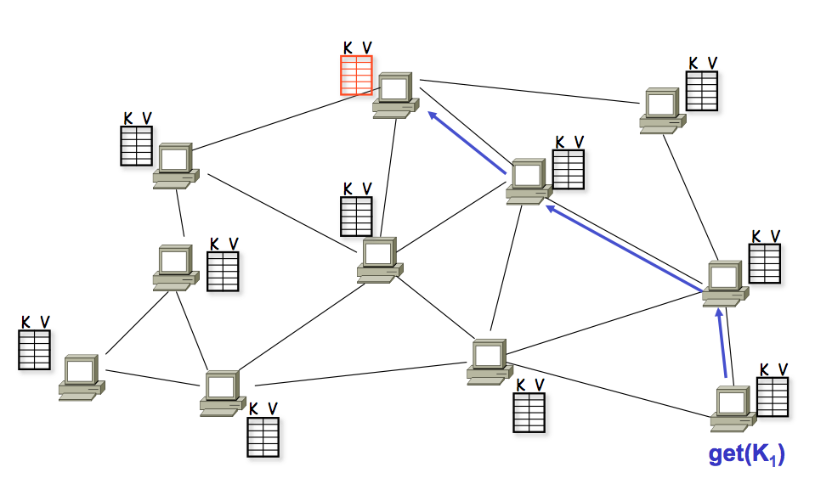
A DHT in Operation: get()

Slide 69
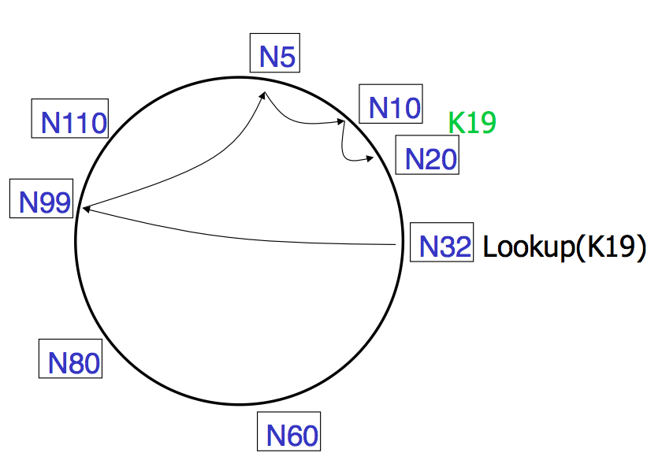
Lookups take O(log(N)) hops

Slide 70
Failures might cause incorrect lookup
N120
N10
N113
^{Lookup(90)}
N102
N85
N80
N80 doesn't know correct successor, so incorrect lookup

Slide 71
Review: Raft and Distributed Computation

Slide 72
Review: Replication is everywhere for storage
For performance
  Higher throughput: replicas can serve concurrently
  Lower latency: cache is also a form of replication
For fault tolerance
  Maintain availability even if some replicas fail

Slide 73
Challenge: Replication Consistency
Optimistic Replication (e.g., eventual consistency)
  Tolerate inconsistency, and fix things up later
  Works well when out-of-sync replicas are acceptable
Pessimistic Replication (e.g., linearizability)
  Ensure strong consistency between replicas
  Needed when out-of-sync replicas can cause serious problems

Slide 74
Review: Replicated State Machines (RSM)
A general approach to making consistent replicas of a server:
  Start with the same initial state on each server
  Provide each replica with the same input operations, in same order
  Ensure all operations are deterministic
    E.g., no randomness, no reading of current time, etc.
These rules ensure each server will end up in the same final state

Slide 75
Review: Inconsistency of Replicas
Problem: replicas can become inconsistent
  Issue: clients' requests to different servers can arrive in different order
  How do we ensure the servers remain consistent?
    Unlike optimistic replication (e.g., eventual consistency), we cannot re-order events later, we must order it right now

Slide 76

Raft for RSM: replicated log
Clients
shl
Consensus
Module
State
Machine
Consensus
Module
State
Machine
Consensus
Module
State
Machine
Servers
Log
Log
Log
add
jmp
mov
shl
add
jmp
mov
shl
add
jmp
mov
shl
Replicated log => replicated state machine
  All servers execute same (deterministic) commands in same order
Consensus module ensures proper logs are the same!

Slide 77
Raft’s high-level approach: problem decomposition
Leader election
  Select one server as the leader
  Detect crashes, choose new leader
Log replication (normal operation)
  Leader accepts commands from clients, append to its log
  Leader replicates its log to other servers (overwrites inconsistencies)
Safety
  Keep logs consistent
  Only servers with up-to-date logs can become the leader
Notes:
Safety can violate if a replication happens partially

Slide 78
Raft server state switch: Heartbeats & Timeouts
Servers start as followers (except one server is assigned as the leader)
  Followers expect to receive RPCs from leaders or candidates
Leaders must send heartbeats to maintain authority in a term
  If election timeout elapses with no RPCs:
    Follower assumes leader has crashed
    Follower starts new election
    Timeouts typically 100-500ms
Notes:
election timeout: a follower receives no communication over a period of time

Slide 79
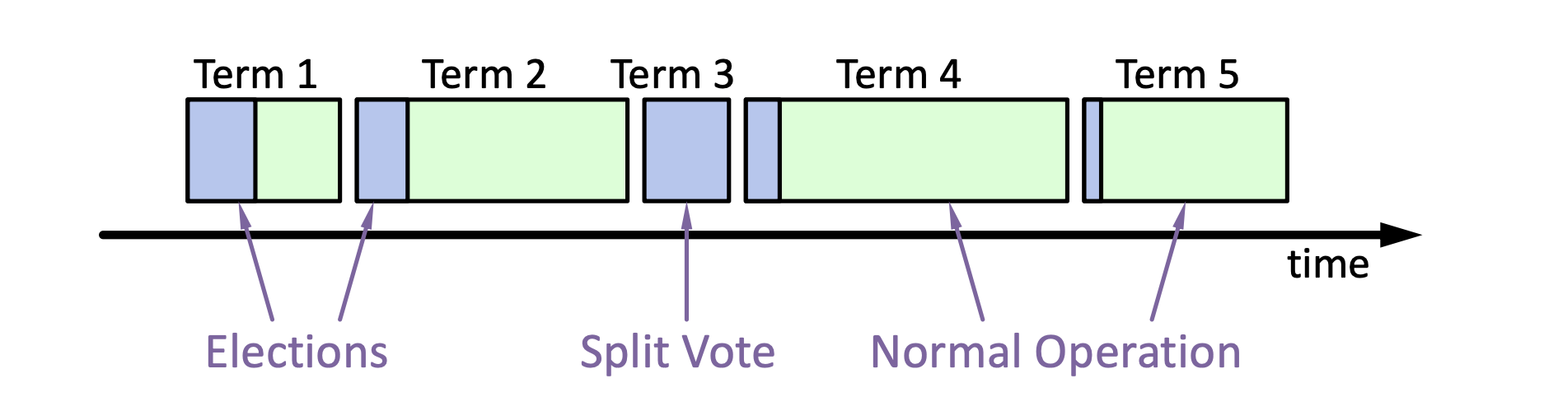
Review: Election Basics
Change its state to the candidate state
Increment current term
Vote for itself
  Send RequestVote RPCs to all other servers, retry until either
    Receive votes from majority of servers ➔ Become the leader!
    Receiver RPC from a valid leader ➔ Return to the follower
Question: what is the condition for the follower to vote?
The leader’s term >= self’s term & never vote before
Notes:
Use heartbeat to announce the leadership.

Slide 80
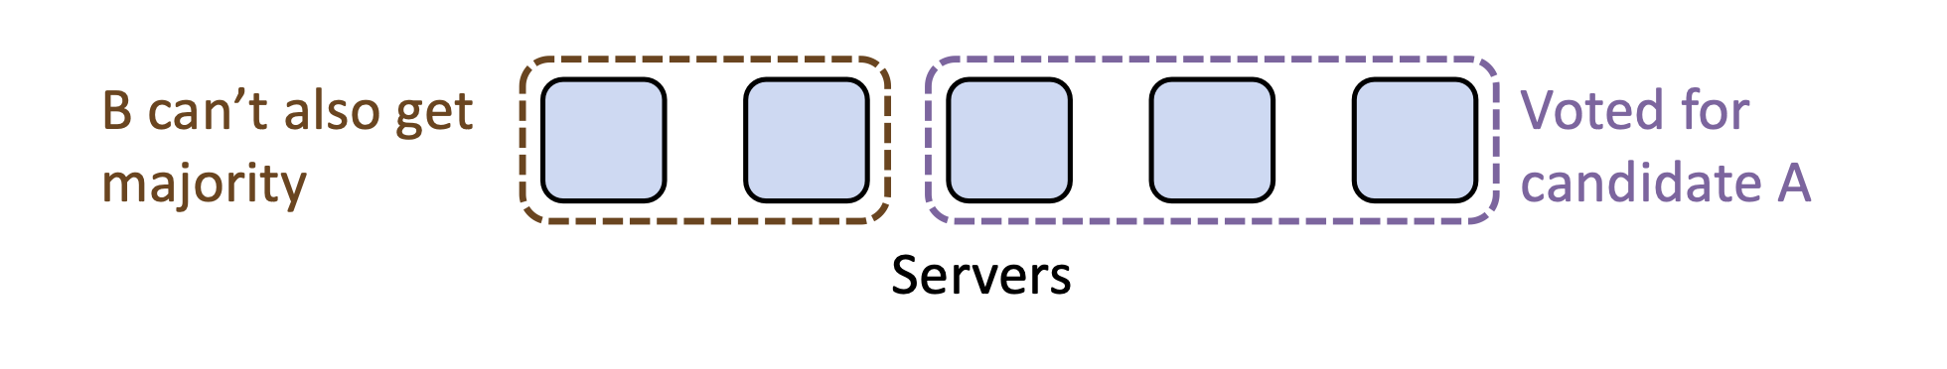
Election requirements: safety & liveness
At most one winner per term
  How to achieve so? Each server only gives one vote per term (persist on disk)
  Majority ensures at least one leader (similar to phase #1 of Paxos)
Some candidate must eventually win
  If multiple candidates started, non will win

Slide 81
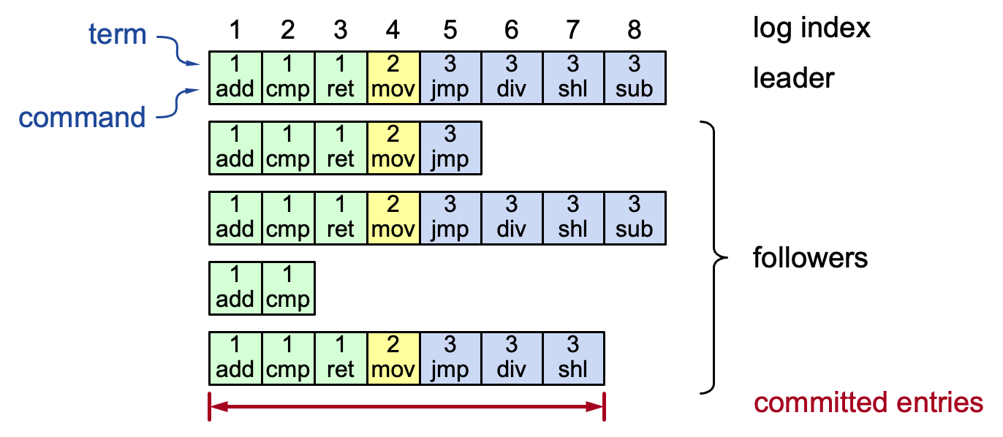
Log structure
Log entry = index, term, command
  Stored on the disk to tolerate failures
A log is committed if it can be safely applied to the state machine
  i.e., eventually stored on all the servers with the same value
Not all entries are committed (will talk about later)
Notes:
Interesting things:
Each log entry store an additional term
Commit: can safely execute on the state machine, no others will execute a different command

Slide 82
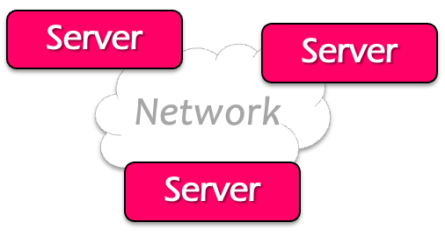

Review: normal operations to update the log
Command
Client
Send command to the leader
Leader appends command to its log
Leader sends AppendEntries RPCs to followers
Once a new entry (of log) committed:
  Leader passes command to its state machine, returns results to client
  Notifies followers of committed entries, Follower pass committed commands to their state machines

Slide 83
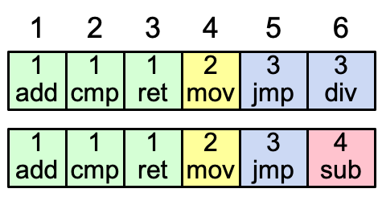
Consistency of the raft’s log
High level of coherency between logs maintained by the raft:
  If log entries on different servers have the same index & term
    They store the same command
    The logs are identical in all preceding entries
If a given entry is committed, all preceding entries are also committed
  Note that not all log entries are committed
Notes:
Commands must be equal: issued by the same leader

Slide 84
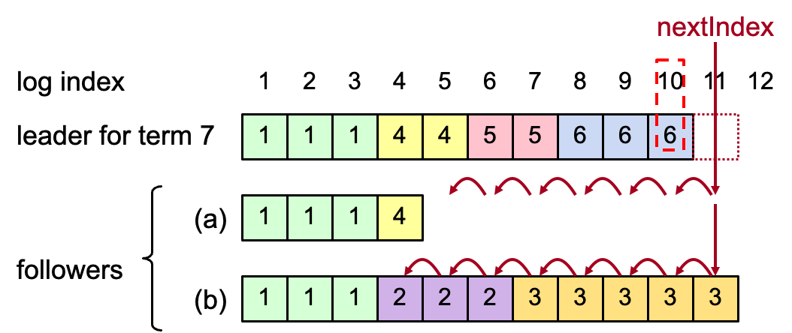
AppendEntries consistency checks + repair
Each RPC argument contains
  Append index, term, term of entry preceding new ones
Follower checks whether it has the matching entry
  Otherwise, it rejects the request

Slide 85
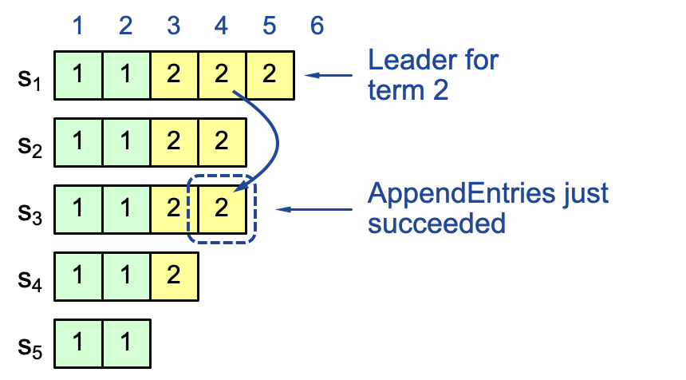
Raft’s intuitive commit rule: replicating on a majority
If the log is replicated on a majority of servers, it can be replicated on the state machine
  Not always true on raft so far

Slide 86
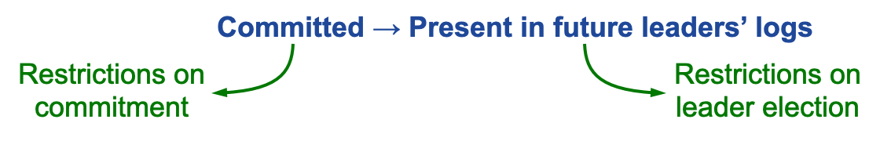
Safety requirement of the commit entry
Once a log entry has been applied to a state machine, no other state machine must apply a different value for that log entry
Raft safety property:
  If a leader has decided that a log entry is committed, that entry will be present in the logs of all future leaders (no overwritten)
This guarantees the safety requirement
  Leaders never overwrite entries in their logs
  Only entries in the leader’s log can be committed
  Entries must be committed before applying to state machine
Notes:
1. Delay the commitment of an entry until we know it is committed

Slide 87
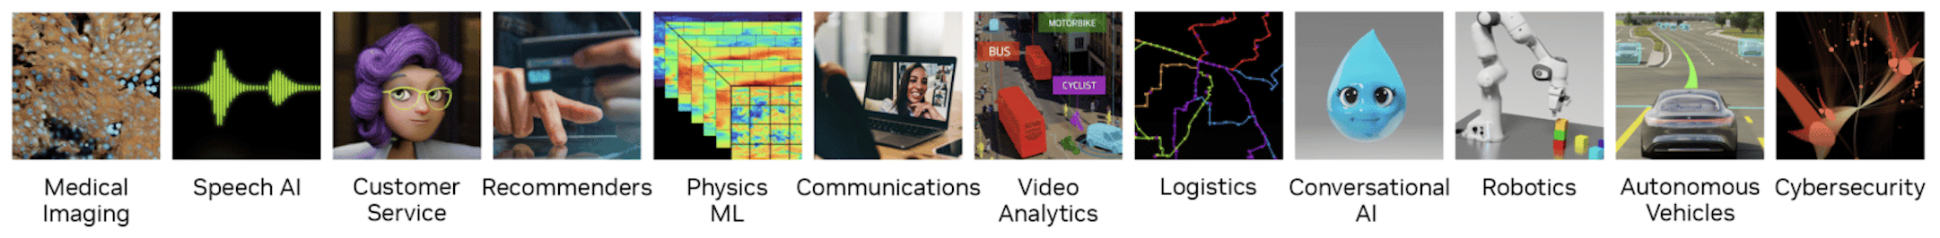
Systems: storage, compute and network
Storage
Power
Network
Power
Compute
Power

Slide 88
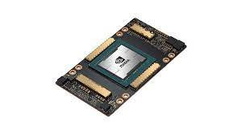
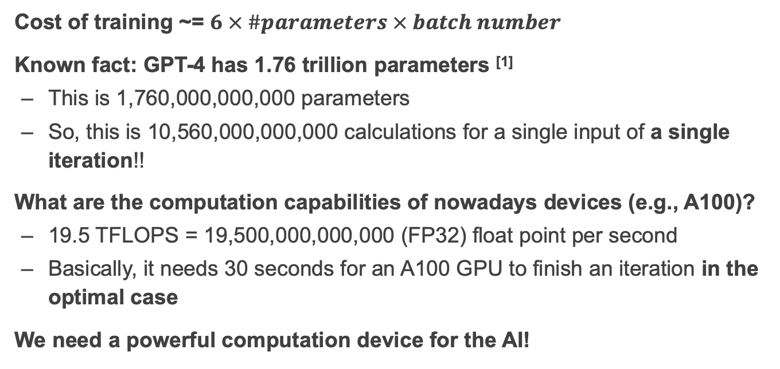
Review: (Approximate) computation for NN like ChatGPT
Cost of training ~= $6 × \#parameters × batch number$
Known fact: GPT-4 has 1.76 trillion parameters ^{[1]}
  This is 1,760,000,000,000 parameters
  So, this is 10,560,000,000,000 calculations for a single input of a single iteration!!
What are the computation capabilities of nowadays devices (e.g., A100)?
  19.5 TFLOPS = 19,500,000,000,000 (FP32) float point per second
  Basically, it needs 30 seconds for an A100 GPU to finish an iteration in the optimal case
We need a powerful computation device for the AI!
[1] https://the-decoder.com/gpt-4-has-a-trillion-parameters/

Slide 89
Review: scaling a single-device with parallelism
General methods
  Single core+: pipeline + super scalar with instruction level parallelism (ILP)
  Single core++: added SIMD support
  Single core+++: domain-specific accelerators (e.g., matrix accelerators)
  Multiple core: a single core (single core, single core+, single core++, single core+++) can be glued together !
Question
  What is the trade-off?

Slide 90
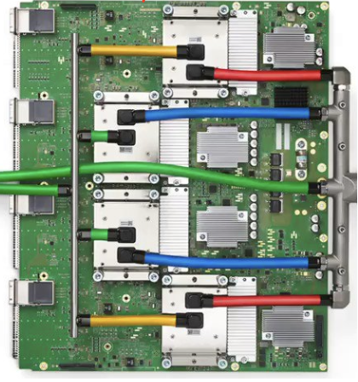



Review: Devices available for computation
Programmability
Intel i5-9600K,
single core: 6.3GFLOPS
Multiple cores: 37.7GFLOPS
Mate60 GPU
2.3 TFLOPs
Apple M2
GPU 3.6 TFLOPs
NVIDIA A100
GPU 19.5 TFLOPs
Google TPUv4
275 TFLOPS
Performance
Notes:
Source: Wikipedia
Mate60: https://nanoreview.net/en/soc-compare/qualcomm-snapdragon-875-vs-hisilicon-kirin-9000
Intel CPU: https://setiathome.berkeley.edu/cpu_list.php

Slide 91
Simply add computation is insufficient!
Accessing memory (or other storage) & Roofline model

Slide 92
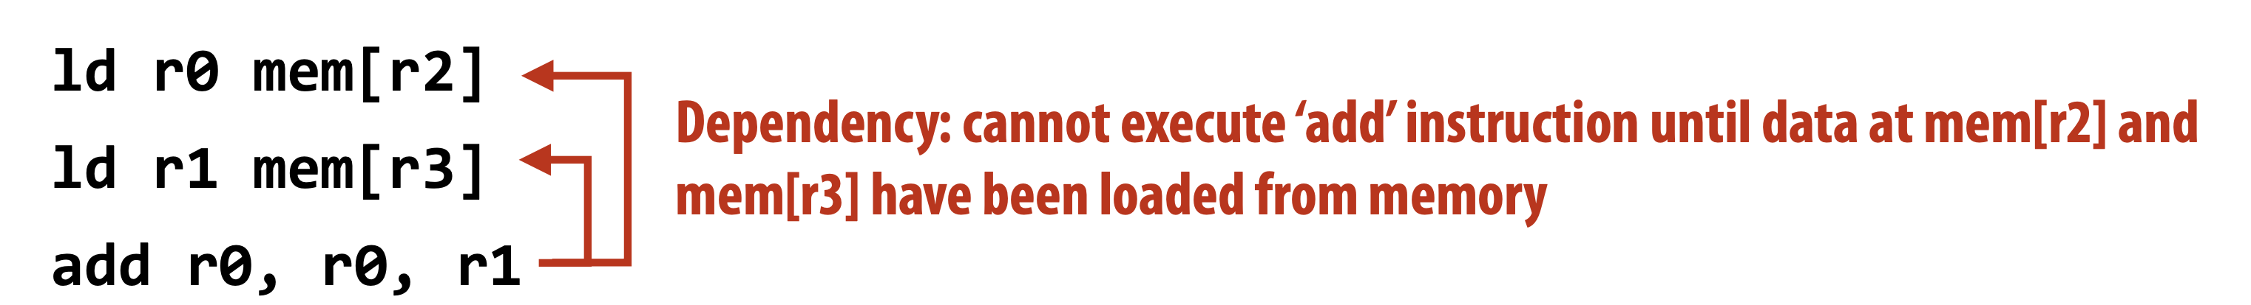
Memory stalls (Communication stalls)
A processor “stalls” when it cannot run the next instruction in an instruction stream because of a dependency on a previous instruction.
Accessing memory is a major source of stalls
Memory access times ~ 100’s of cycles
  Memory “access time” is a measure of latency
Reducing memory stalls is a large topic, out of the scope of this lecture

Slide 93
Terminology
Memory (storage) latency
  The amount of time for a memory request (e.g., load, store) from a processor to be serviced by the memory system
  E.g., 100 cycles, 100 nsecs
Memory (storage) bandwidth
  The rate at which the memory system can provide data to a processor
  E.g., 20Gbps
Time to load the data = Latency + Payload / bandwidth

Slide 94
Review: the roofline model
A computation task should look at capabilities other than the computation
Given an application
  If we know how many FLOPs performed per-memory read, we can see whether it is computation bound or memory bound
Benefit
  Give hints on the optimization directions
128
64
Peak flops
32
16
attainable Gflop/s
Stream Bandwidth
8
4
Kernel’s Arithmetic Intensity
2
1
¹/₈
¹/₄
¹/₂
1
2
4
8
16
flop:DRAM byte ratio

Slide 95
Review: Why distributed computing?
Large computation requirements
  E.g., training AI models, huge floating points required for each iteration
  = 6 * #parameters * Batch size
  The trend continues
Single device FLOPS (floating points per second) is insufficient
  2X speed improvements per-year
  Training computation required: 240+ X required per-year

Slide 96
Logical process for doing a computation distributedly
A large problem to solve, e.g., log processing, AI training
Decompose
Sub-problems. Many alias, e.g., sub-tasks, sub-jobs (or simply jobs)
Assignment
A set of physical programs that can run on parallel units, e.g., a thread or a GPU kernel
Runtime Orchestration (or scheduling)

Slide 97
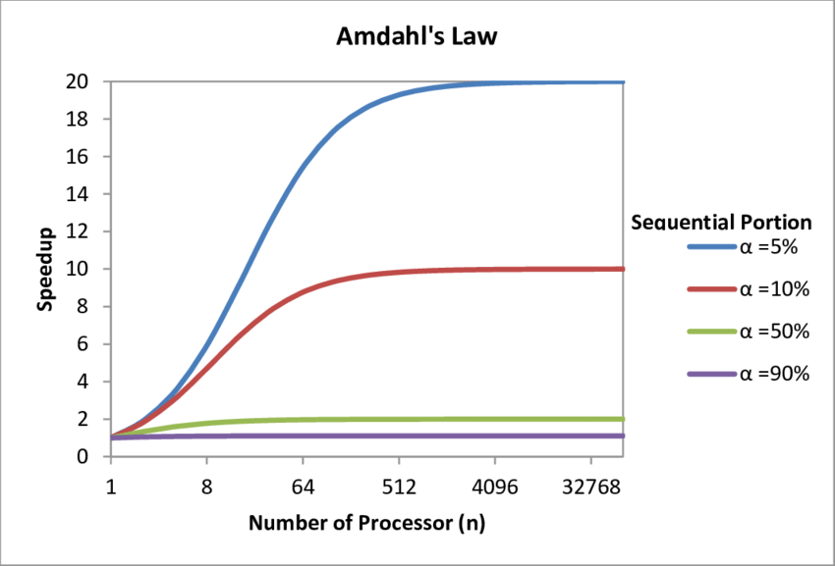
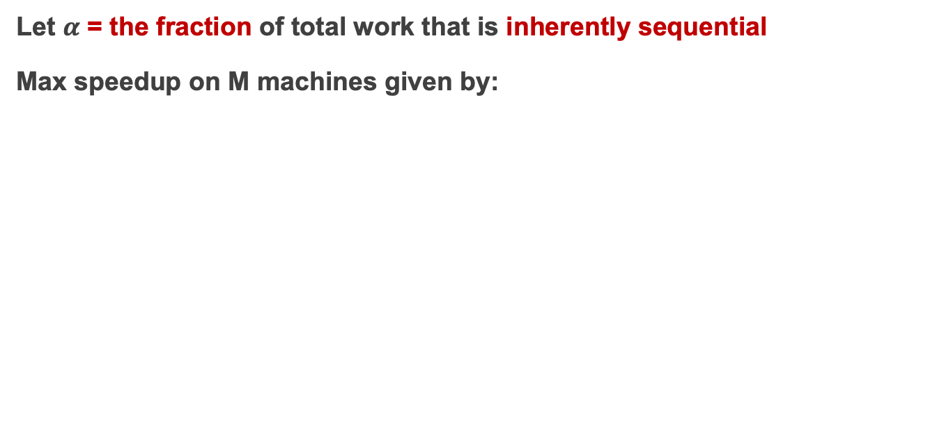
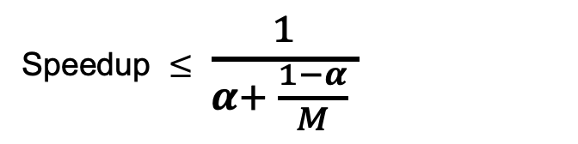
Review: Amdahl’s Law for decomposing the tasks
Let $α$ = the fraction of total work that is inherently sequential
Max speedup on M machines given by:
Speedup $≤$ $\frac{1}{α+ \frac{1−α}{M} }$
Takeaway: we should reduce sequential part during distributed computation
Source: https://www.researchgate.net/figure/Graph-demonstrating-Amdahls-Law_fig2_315696585
Notes:
Amdahl law can consider heterogeneous version, e.g., different parallel cores have different parallel processing capabilities.

Slide 98
More implementation details to consider
Sending data to/from nodes
Coordinating among nodes
Recovering from node failure
Optimizing for locality
Partition data to to enable more parallelism
Common to many jobs! E.g., batch processing, graph processing, machine learning, etc.

Slide 99
Review: we build a framework to hide the above tasks
Goal
  Reduce programmer’s effort in solving the above challenges
Challenges
  What are the abstraction? Thread & RPC is insufficient
  More general, harder to provide the above property
  E.g., if a thread fails, how can we know its progress?
    It’s a very hard problem, we will come back to it later
Existing abstractions: MapReduce & Computation graph (DAG)

Slide 100
MapReduce vs. DAG
Sending data to/from nodes (both done)
Coordinating among nodes (both done)
Recovering from node failure (both done)
Optimizing for locality (both done)
Partition data to to enable more parallelism ?
  MapReduce: jobs are naturally parallelized w/ its abstraction
  But in DAG, the level of parallelism depends on the structure of DAG!
We need some domain-specific knowledge to help partition the graph node for more parallelism in DAG

Slide 101
Case study: distributed training

Slide 102
Review: Ideal Metric of Success for Efficient Training
“Learning”
Second
“Learning”
Record
Record
Second
=
x
Convergence
Machine Learning
Property
Throughput
System
Property

Slide 103
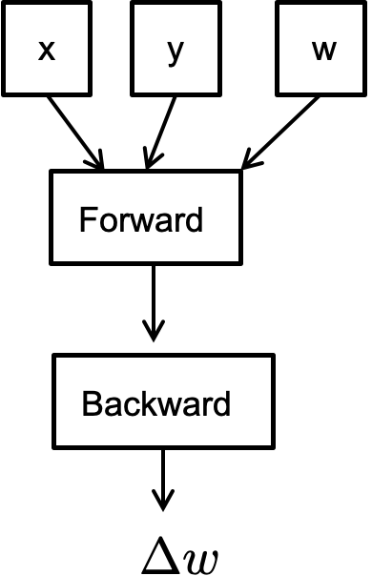
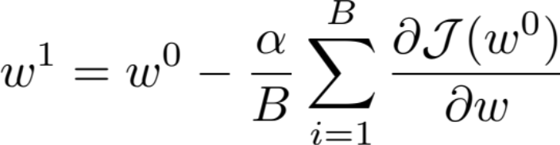
Review: Pseudocode for Stochastic Gradient Descent
// execute on a master
for iter in num_iters:
iter
iter+1
iter
Note: expressed as DAG ☺

Slide 104
Review: Parallelization Opportunities
Data Parallelism: Distribute the processing of data to multiple PEs.
Model Parallelism: Break the model and distribute processing of every layer to multiple PEs
For either approach it is also possible to use synchronous or asynchronous updates

Slide 105
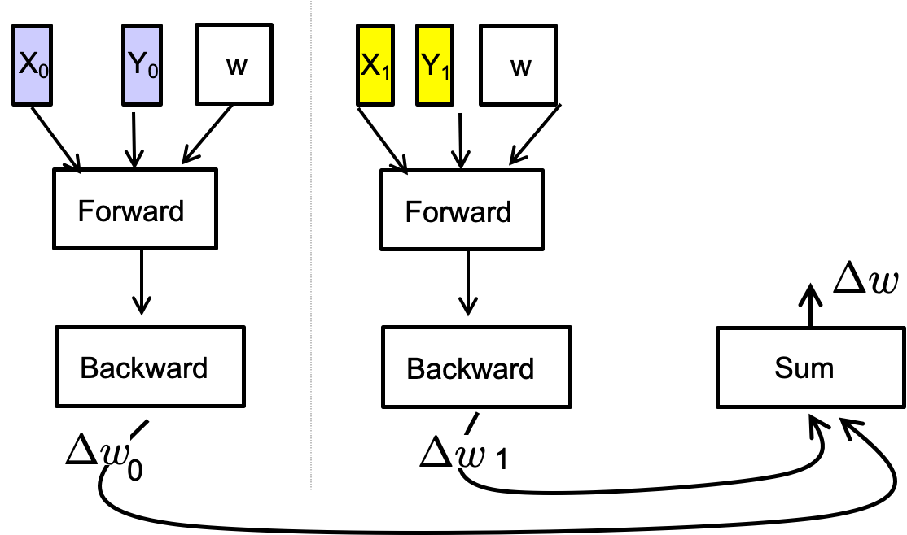
Review: Pseudocode for (iterative) data parallel
// execute on a master
for iter in num_iters:
iter
iter+1
iter
The master will do the coordination
  Similar to the Job manager in Dryad

Slide 106


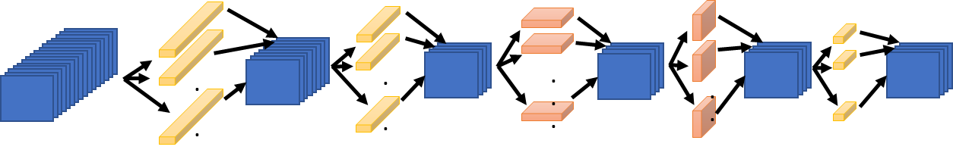
Synchronous Data Parallelism w/ BSP
1024
Store the entire model (W) on each processor
  Then distribute the batch evenly across each processor
  E.g., 64 images per GPU
Question: how to sync between iterations?
GPU 1
GPU 2
GPU 3
GPU 16
64
64
64
64
fprop
fprop
fprop
fprop
…
bprop
bprop
bprop
bprop
Communicating & syncing gradients

Slide 107
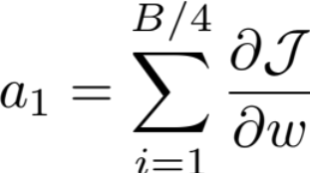
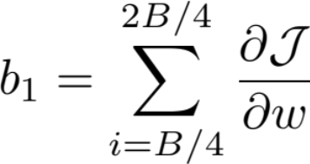
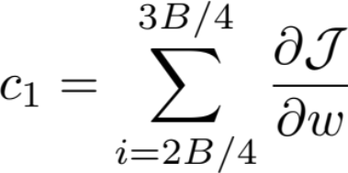


Key operator: allreduce
GPU 1
GPU 2
GPU 3
GPU 4
ALLREDUCE

Slide 108
Allreduce: put it all together
Trade-off between rounds vs. fan-in performance
 | Round | Peak node bandwidth | Per-node fan-in
Parameter server (PS) | O(1) | O(N * P) | O(P)
Decentralized Allreduce | O(P) | O(N) | O(1)
Ring allreduce | O(2 * P) | O(N/P) | O(1)

Slide 109
Drawback of data parallelism: replicated model
Data parallelism assumes the model (parameters) are replicated on all the processes
  Such that they can do the forward & backward pass dependently
  What if the model cannot fit onto the device?
Current trends: models are becoming larger and larger
  No country (or company) can tolerate the risk of falling behind in the AI race

Slide 110

Model parallelism
Partition the parameters of a model, typically done in two ways:
  Partition on the layer: pipeline parallelism
  Partition on the W: tensor parallelism
X
Y
w1
X
Y
w
Layer #1
W1
W2
w2
Forward
Layer #2

Slide 111

Pipeline parallelism
Partition the computation layer-by-layer, each partition is deployed on a device
  Note that different layers can be grouped together
  The strategy is out of the scope of this course
X
Y
w1
Layer #1
w2
Layer #2
The partitioned computation graph
The model

Slide 112











Pipeline parallelism
Bubble where processes are idle
Time
Problem: no parallelism there!
How to reduce bubble?

Slide 113

Technique: micro-batching
Reducing the bubble size by breaking the batch size into smaller pieces to reduce the idle time of the processes
  Reduces bubble size in an easy way to implement
  The batch size = partition size
Question: to what extent can micro-batching improves performance?
  Depends on the bubble size

Slide 114

Pipeline parallelism & the number of micro-batch
Question: what is the bubble size ?
  p – 1 (p == #devices)
Question: what is the overhead?
  $tf$ : time of a forward of a micro-batch (m)
  $tb$ : time of a backward of a micro-batch (m)
  Ideal process time: $m ∗\left(tf+tb\right)$
  Wasted time of bubble: $\left(p −1\right)∗\left(tf+tb\right)$
  Bubble time fraction: $\frac{p −1}{m}$

Slide 115

Tensor parallelism
X
Y
w1
Partition the parameters of a layer
  Each partition is deployed on a separate GPU
Pros
  Support pipeline parallelism with a large layer
  Fit the hardware architecture of modern servers (or we can say that modern servers are built for tensor parallelism ☺ )
Layer #1
w2
Layer #2

Slide 116

Model Parallelism: Forward Pass
d_{i}
B
B
P₀
P₀
P₁
P₀
P₀
P₁
d_{i}/P
d_{i}/P
*
d_{i}
P₁
P₁
W
X
Y^{local}
Y
Requires an all gather communication so that all processes get each others activation data
Same cost as all reduce without the 2x factor
Notes:
\begin{align*}
\sum_{i=1}^{L} \beta (P-1) \frac{Bd_i}{P}\right)
\end{align*}
\begin{align*}
T_{{comm}}({domain}) = &\sum_{i=1}^{L}\left(\alpha {\log(P)}+ \beta \frac{P-1}{P} Bd_i\right)\\
+2&\sum_{i=2}^{L}\left(\alpha {\log(P)}+ \beta \frac{P-1}{P} d_{i-1}\right)
\end{align*}

Slide 117

Put it altogether: parallelize distributed training

